Slide 1
GROUP 5
Alice Baker and Beth Cowle

Slide 2
OVERVIEW
Non-Digital – Card Game
Voting
Bluffing/Deceiving
Hidden Information
Betting
4 – 8 Players
Notes:
Alice

Slide 3
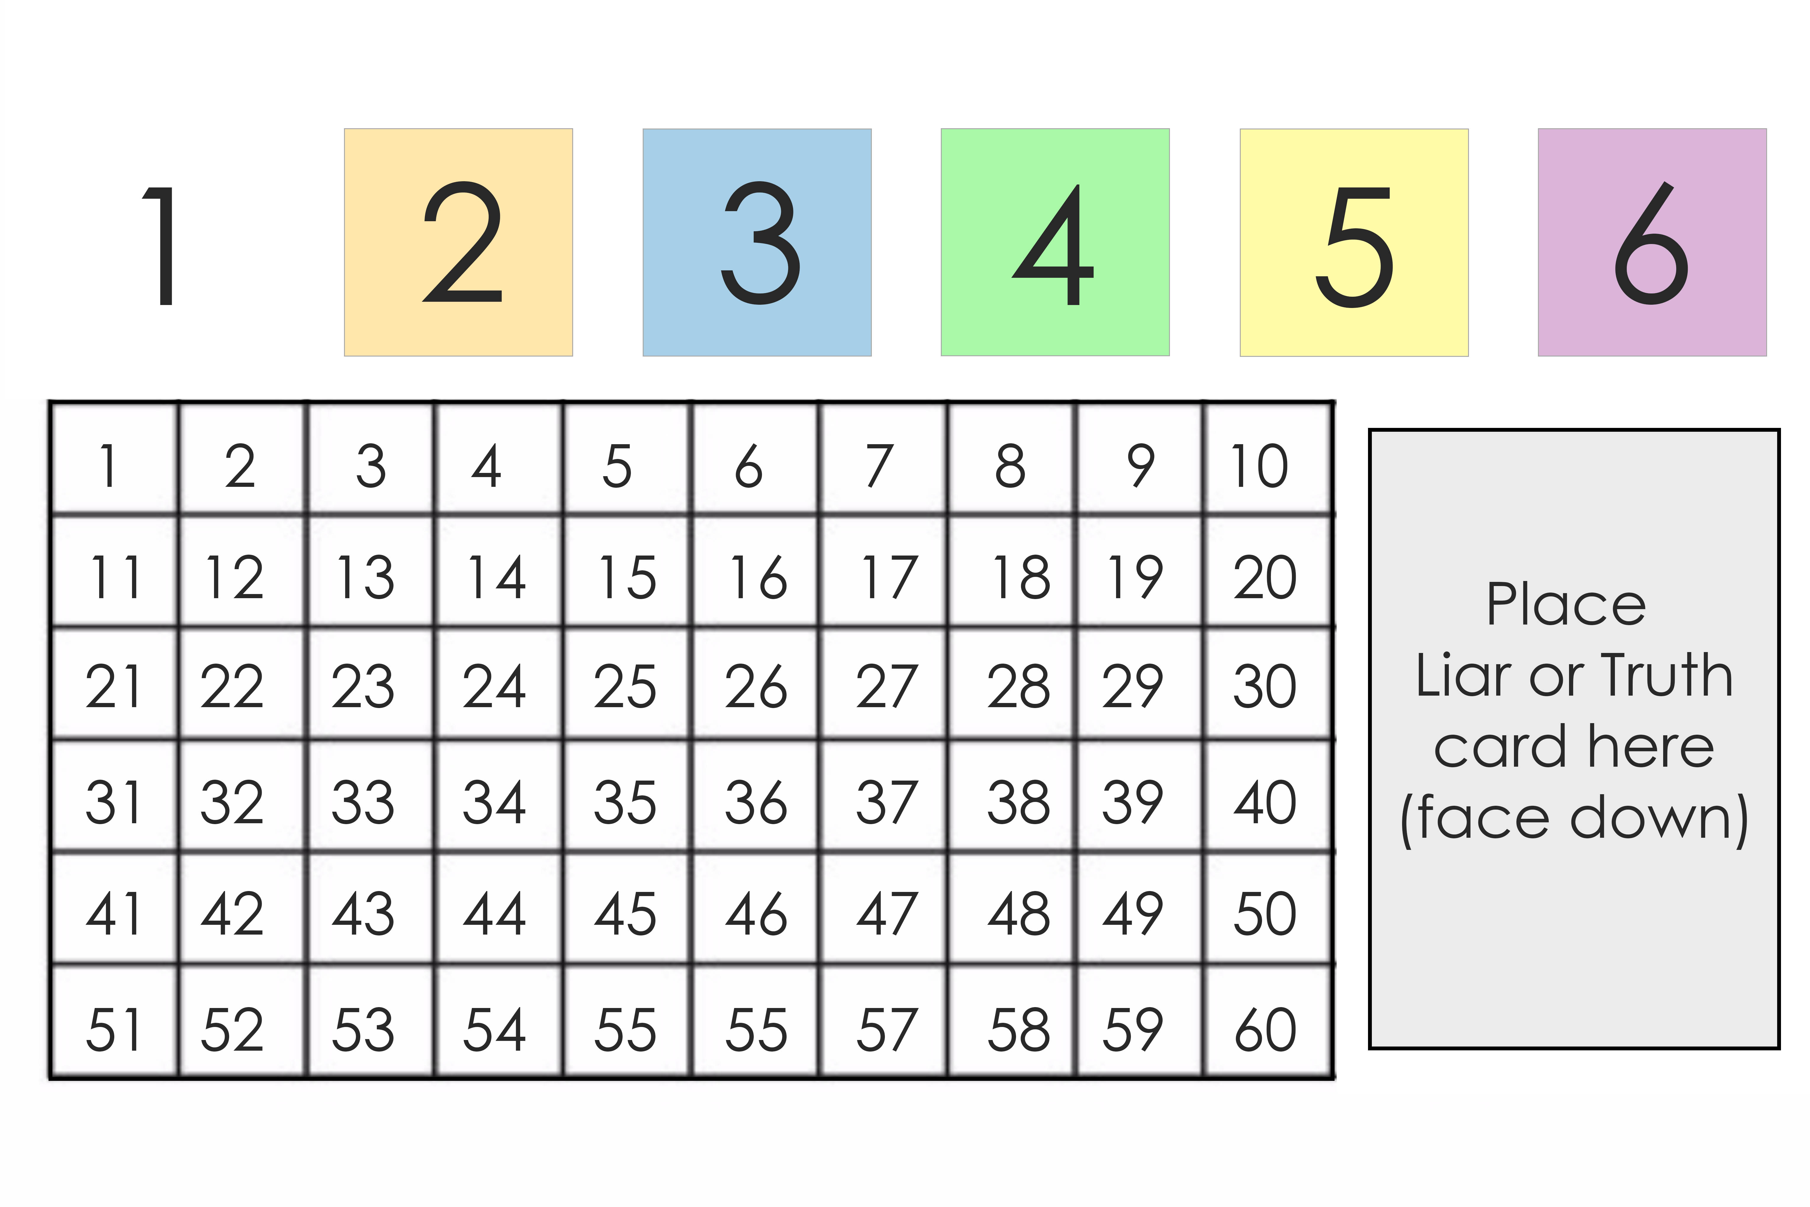
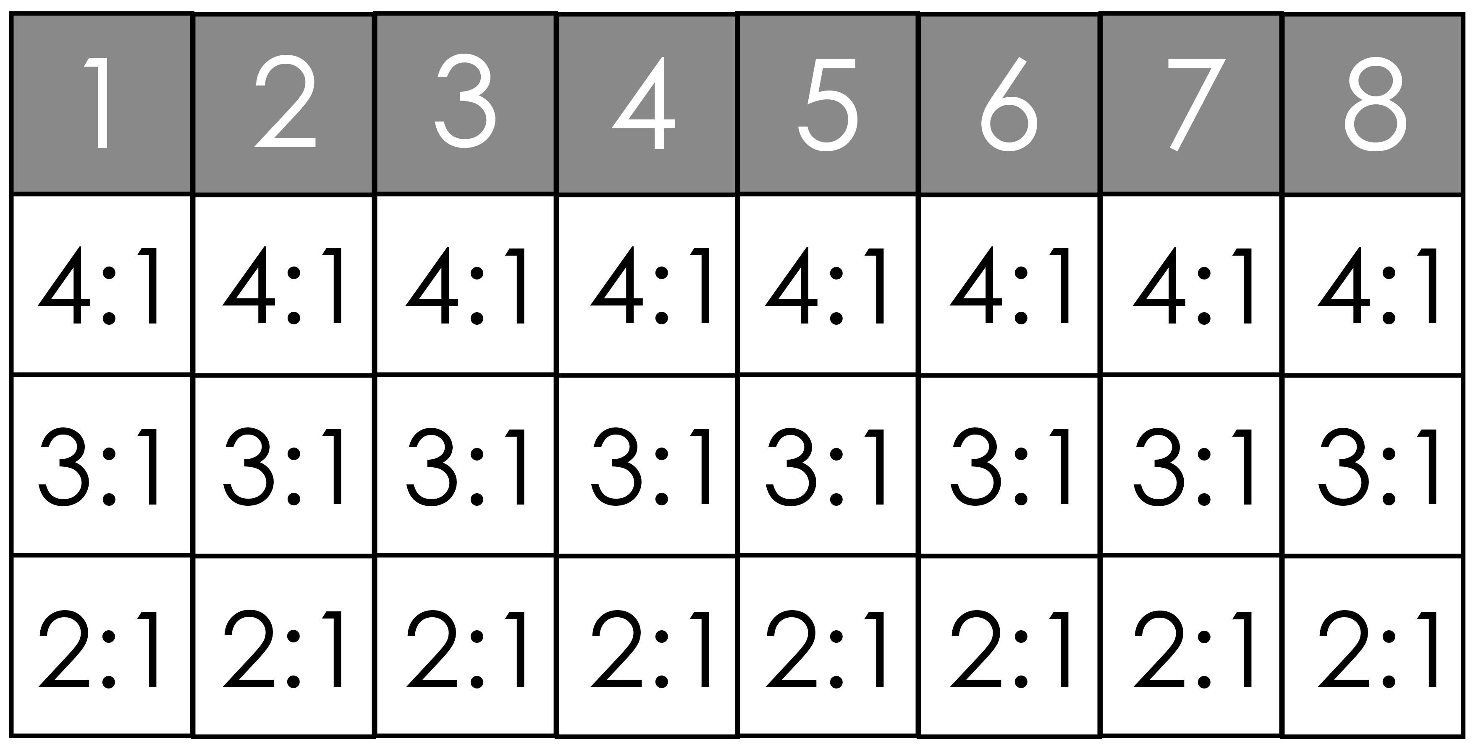
MECHANICS
Betting
- Betting Board
Bidding/Auctioning
- Unsuccessful
Liar/Truth Cards are
now counters
Notes:
Alice

Slide 4
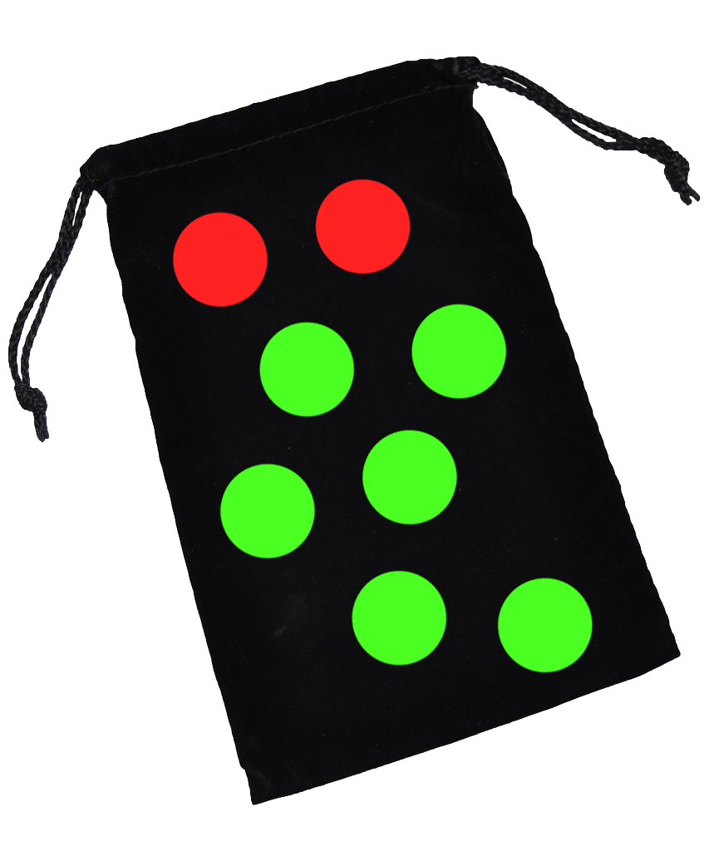
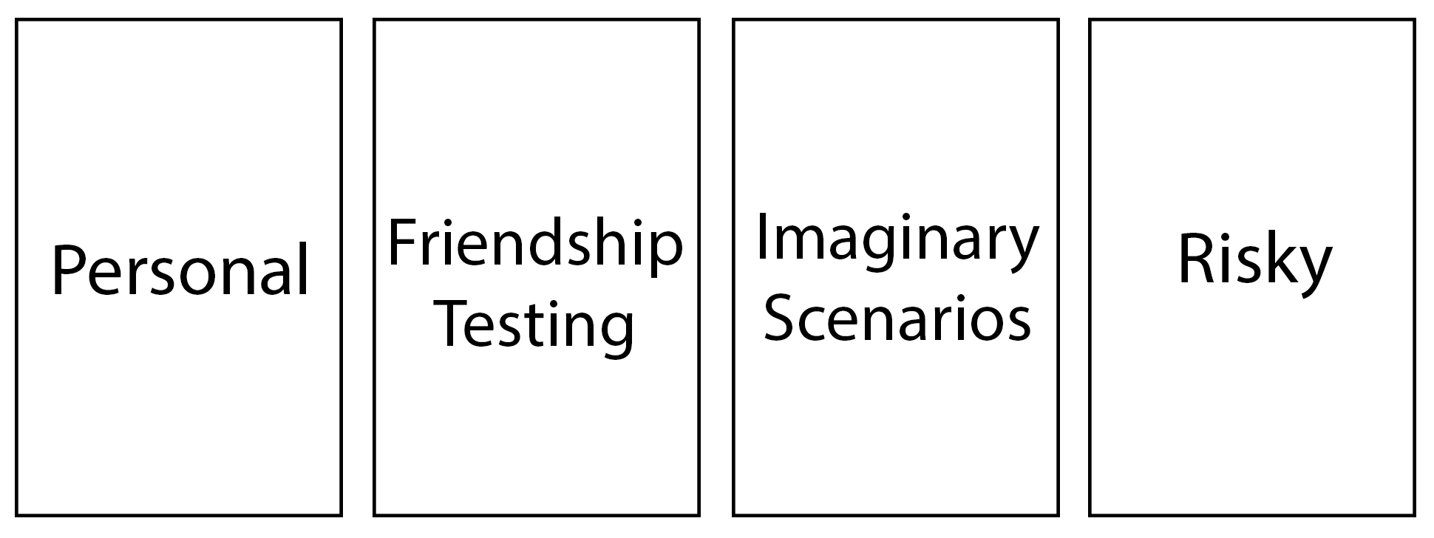
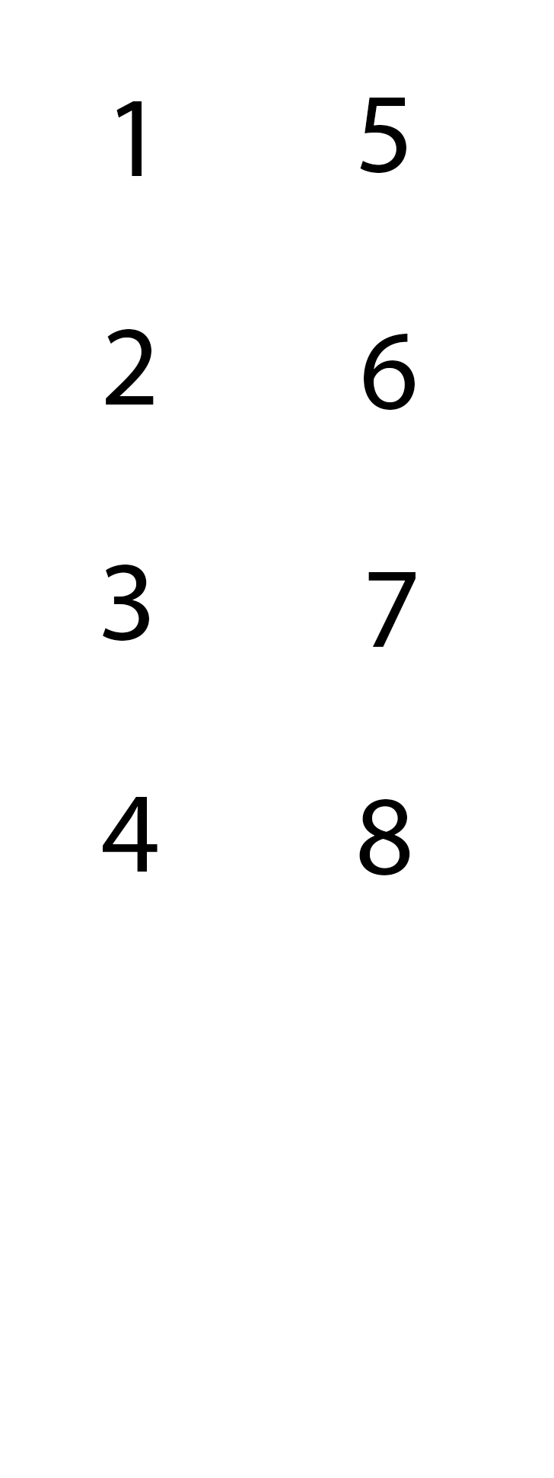

Set-up

Slide 5

Pick Truth/Liar Counters

Slide 6
Pick a Question

Slide 7
Reveal answers

Slide 8
Discuss and question opponents

Slide 9
Betting on liars

Slide 10
Reveal and count up points

Slide 11
Playtesting Iterations
Betting increased tension
Board helped to show odds
Tokens as points – easier to keep track of
Bidding iteration was confusing
Liked writing their answer down first
Bag for liar/truth – Easier than shuffling cards

Slide 12
Features
WEEK | MILESTONES
1 | Playtesting
2 | Iterating and bug fixing
3 | Playtesting
4 | Iterating and bug fixing
5 | Playtesting
6 | Polishing – adjusting final features
7 | Theme
8 | Artwork
9 | Artwork
10 | Finished product – Printed game
Test new mechanics
Theme for the game
Artwork for Board and Cards
Print the Board and Cards

Slide 13
GAMEPLAY
Maximising people fun
5 – 20 minutes per round
Game length depends on amount of players

Slide 14
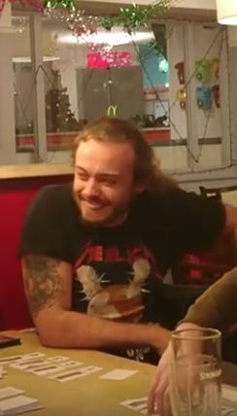
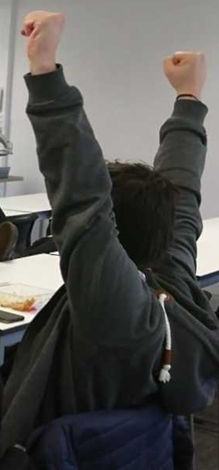
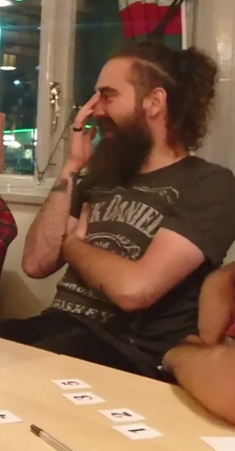

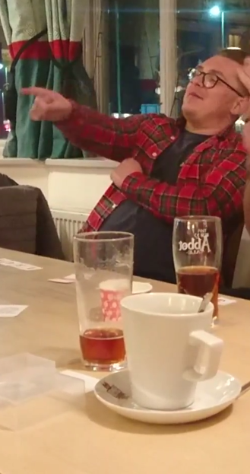
THANKS FOR LISTENING! ANY QUESTIONS?
Notes:
Beth

